Slide 1
R_dot_dot-NasaSpaceAppsChallenge2021
Submission_for_OntologiesAndInteractiveNetworkVisualizations

Slide 2
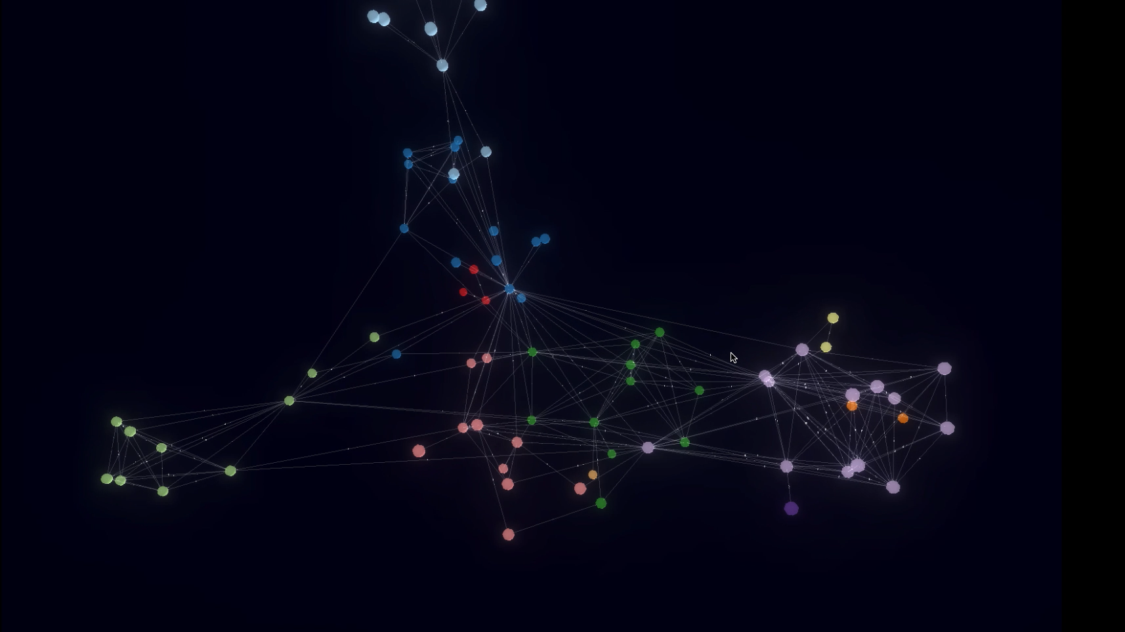

Slide 3
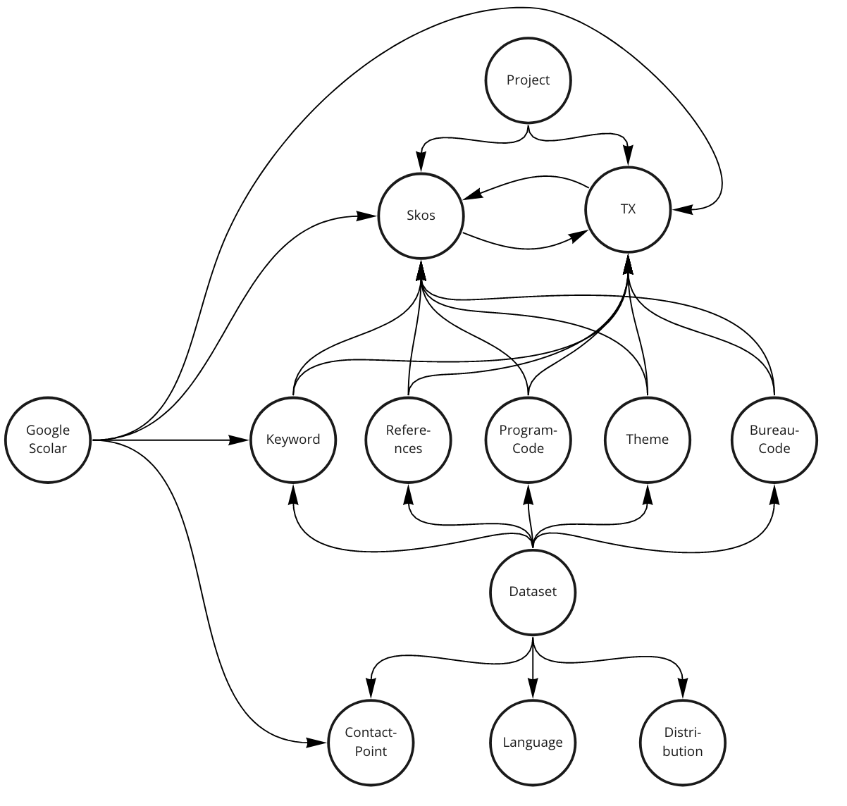
Ontology

Slide 4
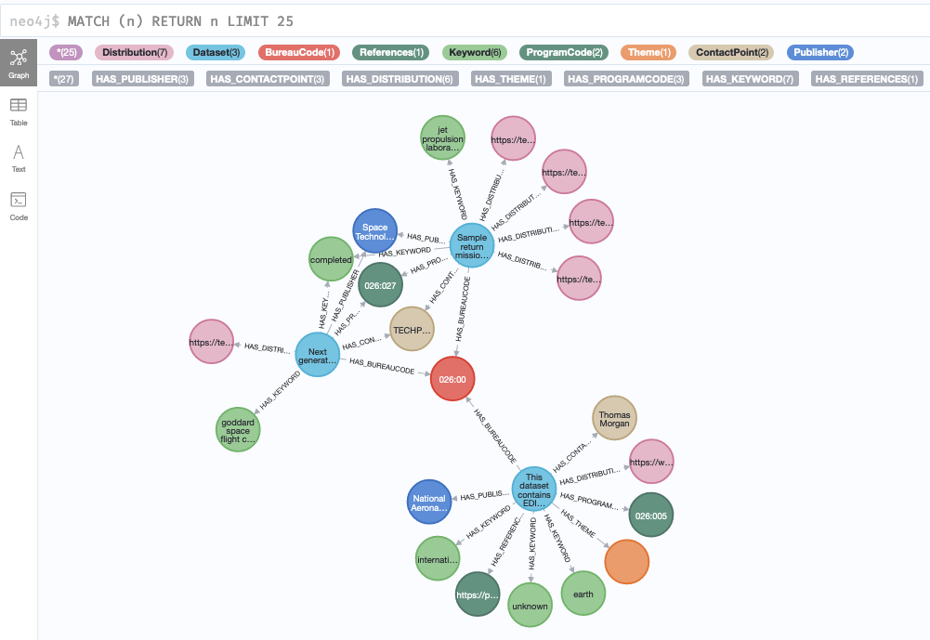

Implementation
https://github.com/lmeow/r_dot_dot-hackathon

Slide 5
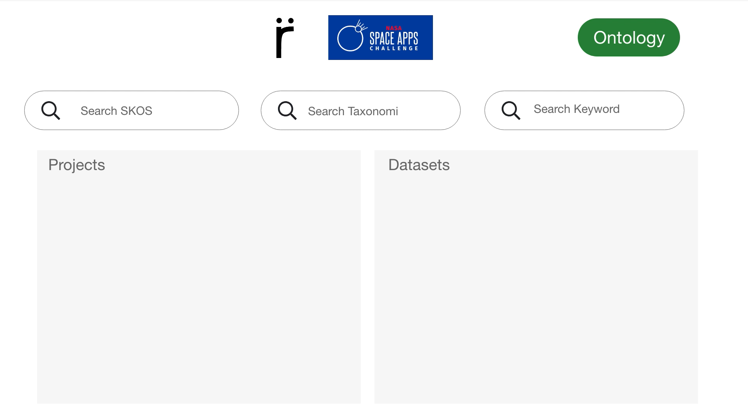
Prototype

Slide 6
